Slide 1
AI magic: crafting student-friendly content with ease
Dr. Anica Lee
Associate Professor of Instruction
Department of Biology

Slide 2
WORKSHOP OBJECTIVES
To introduce AI tools that can reduce stress, save time, and increase engagement
  Chat GPT
  Google Illuminate
  Visla

Slide 3
CHAT GPT
  Chat GPT is an AI-powered chatbot developed by OpenAI that can generate human-like text responses based on prompts
  How to Use Chat GPT for Educational Materials
    Content Creation: Generate lesson plans, quizzes, and summaries
    Research Assistance: Quickly retrieve information and clarify complex concepts
    Idea Generation: Brainstorm new teaching methods and activities

Slide 4
Create Formative Assessments
Go to https://chatgpt.com/
Upload materials you wish as a guide (lectures, pdf of a textbook, paper, etc) into the chat
Type your prompt explaining what material you are providing, what kind of class this is, and what you want from Chat GPT to create
Read the offered answers and choose the one you like, modify as you need to. You can also ask Chat GPT to expand it, add rubrics, etc.

Slide 5
Chat GPT example
Prompt: Here is my lecture for Intro Biology. Students use it as a "textbook". These students are non-majors. This is an online, asynchronous class. I would like you to create 3 formative assignments that students can complete

Slide 6
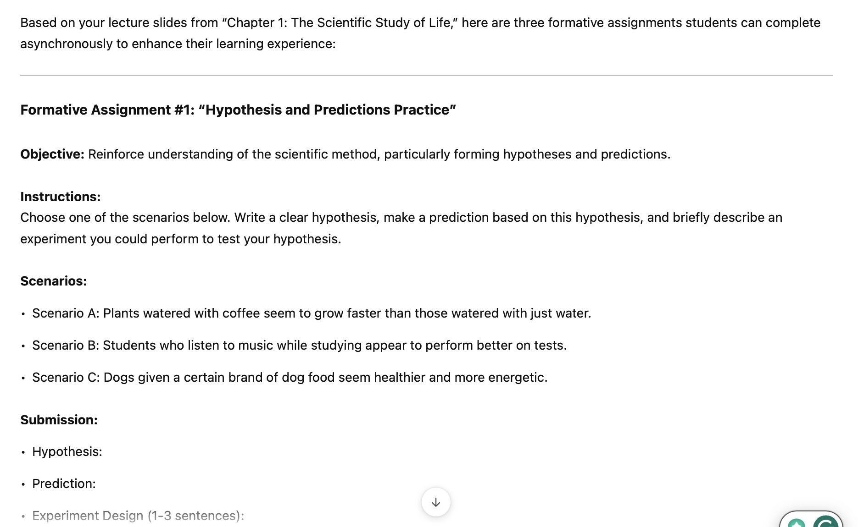
Chat GPT output #1

Slide 7
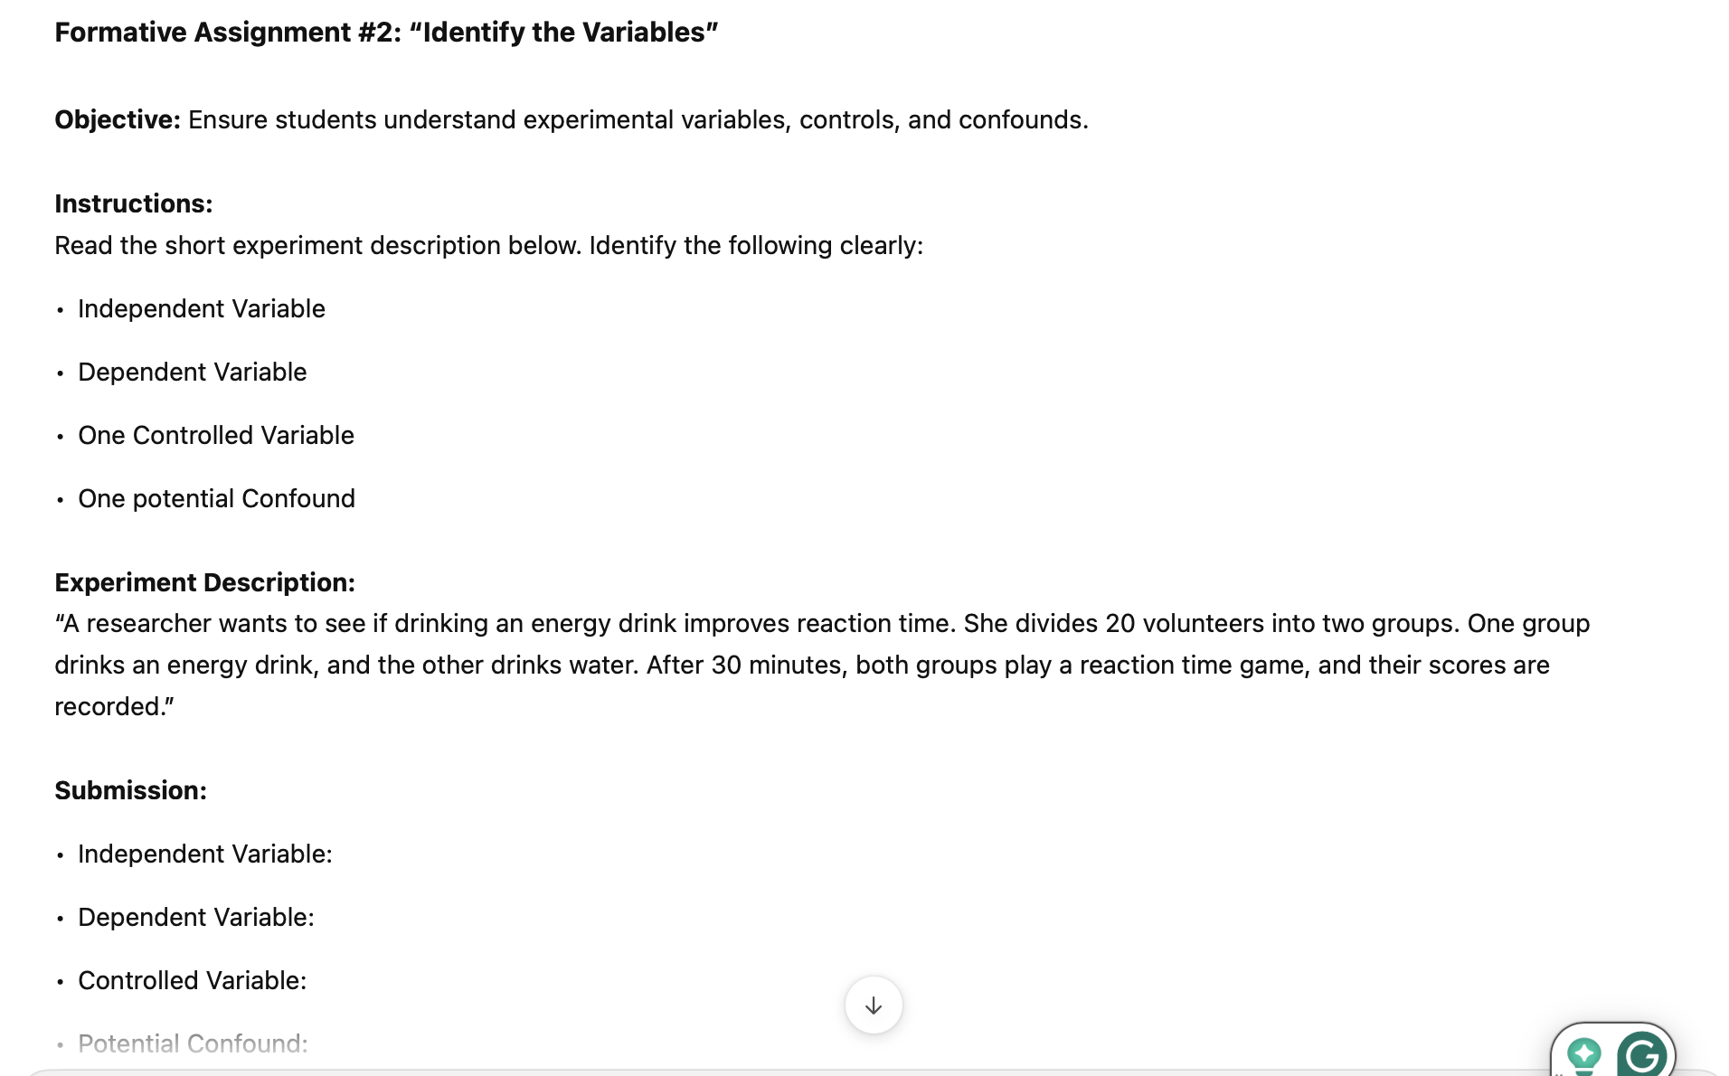
Chat GPT Output #2

Slide 8
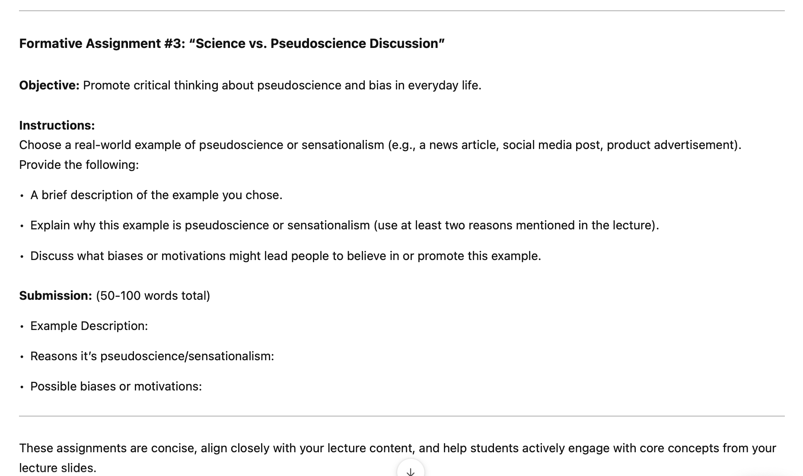
Chat GPT Output #3

Slide 9
What if I wanted a Group Assignment
Prompt: can you add 2 potential group assignments
Answer: Certainly! Here are two additional formative group assignments based on your Chapter 1 lecture, suitable for asynchronous collaboration online:

Slide 10
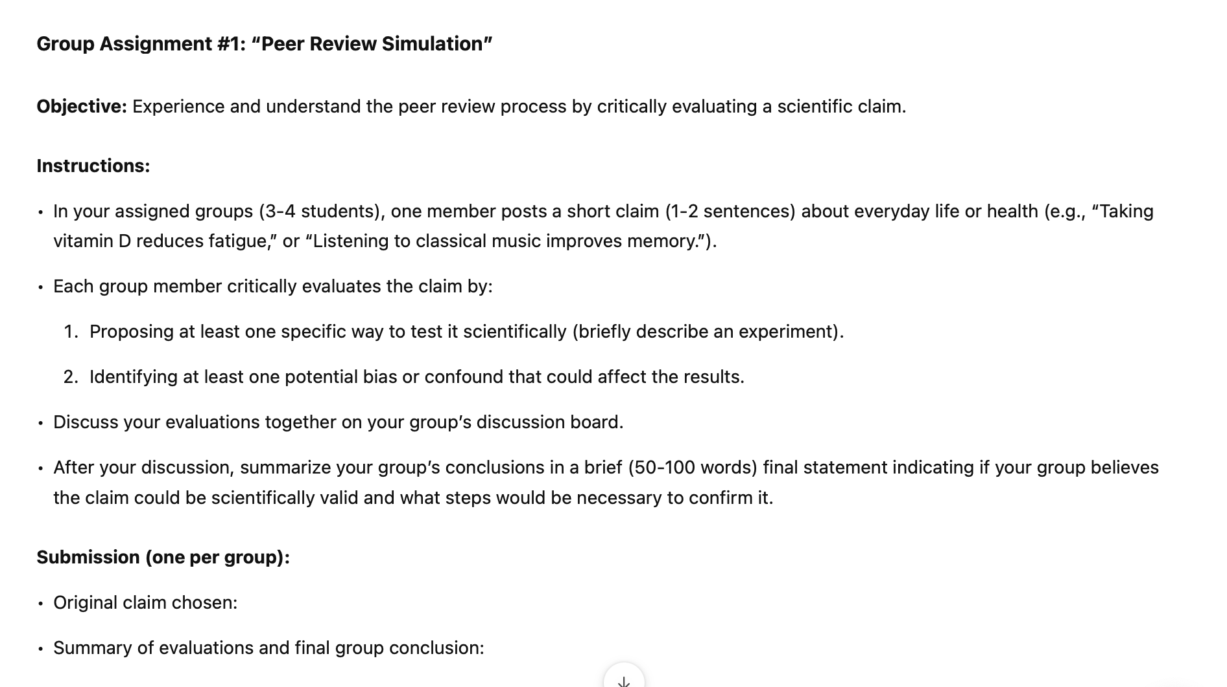
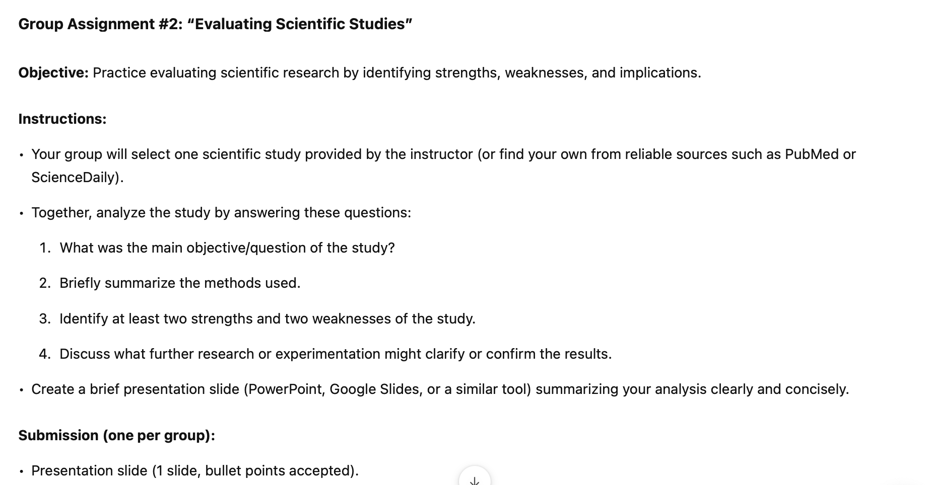
Chat GPT Output #4

Slide 11

Your turn
Is there material your students are struggling with, and you are struggling with creating an engaging Formative assignment
Go to https://chatgpt.com/
Ask ChatGPT for help

Slide 12
Google Illuminate
  Google Illuminate is an AI tool that transforms academic research papers into podcast-style audio discussions
  Usages
    Audio Summaries: Convert dense research papers into engaging audio summaries
    Integration: Use Illuminate with Google Classroom to create and assign activities
    Accessibility: Make complex content more accessible for students

Slide 13
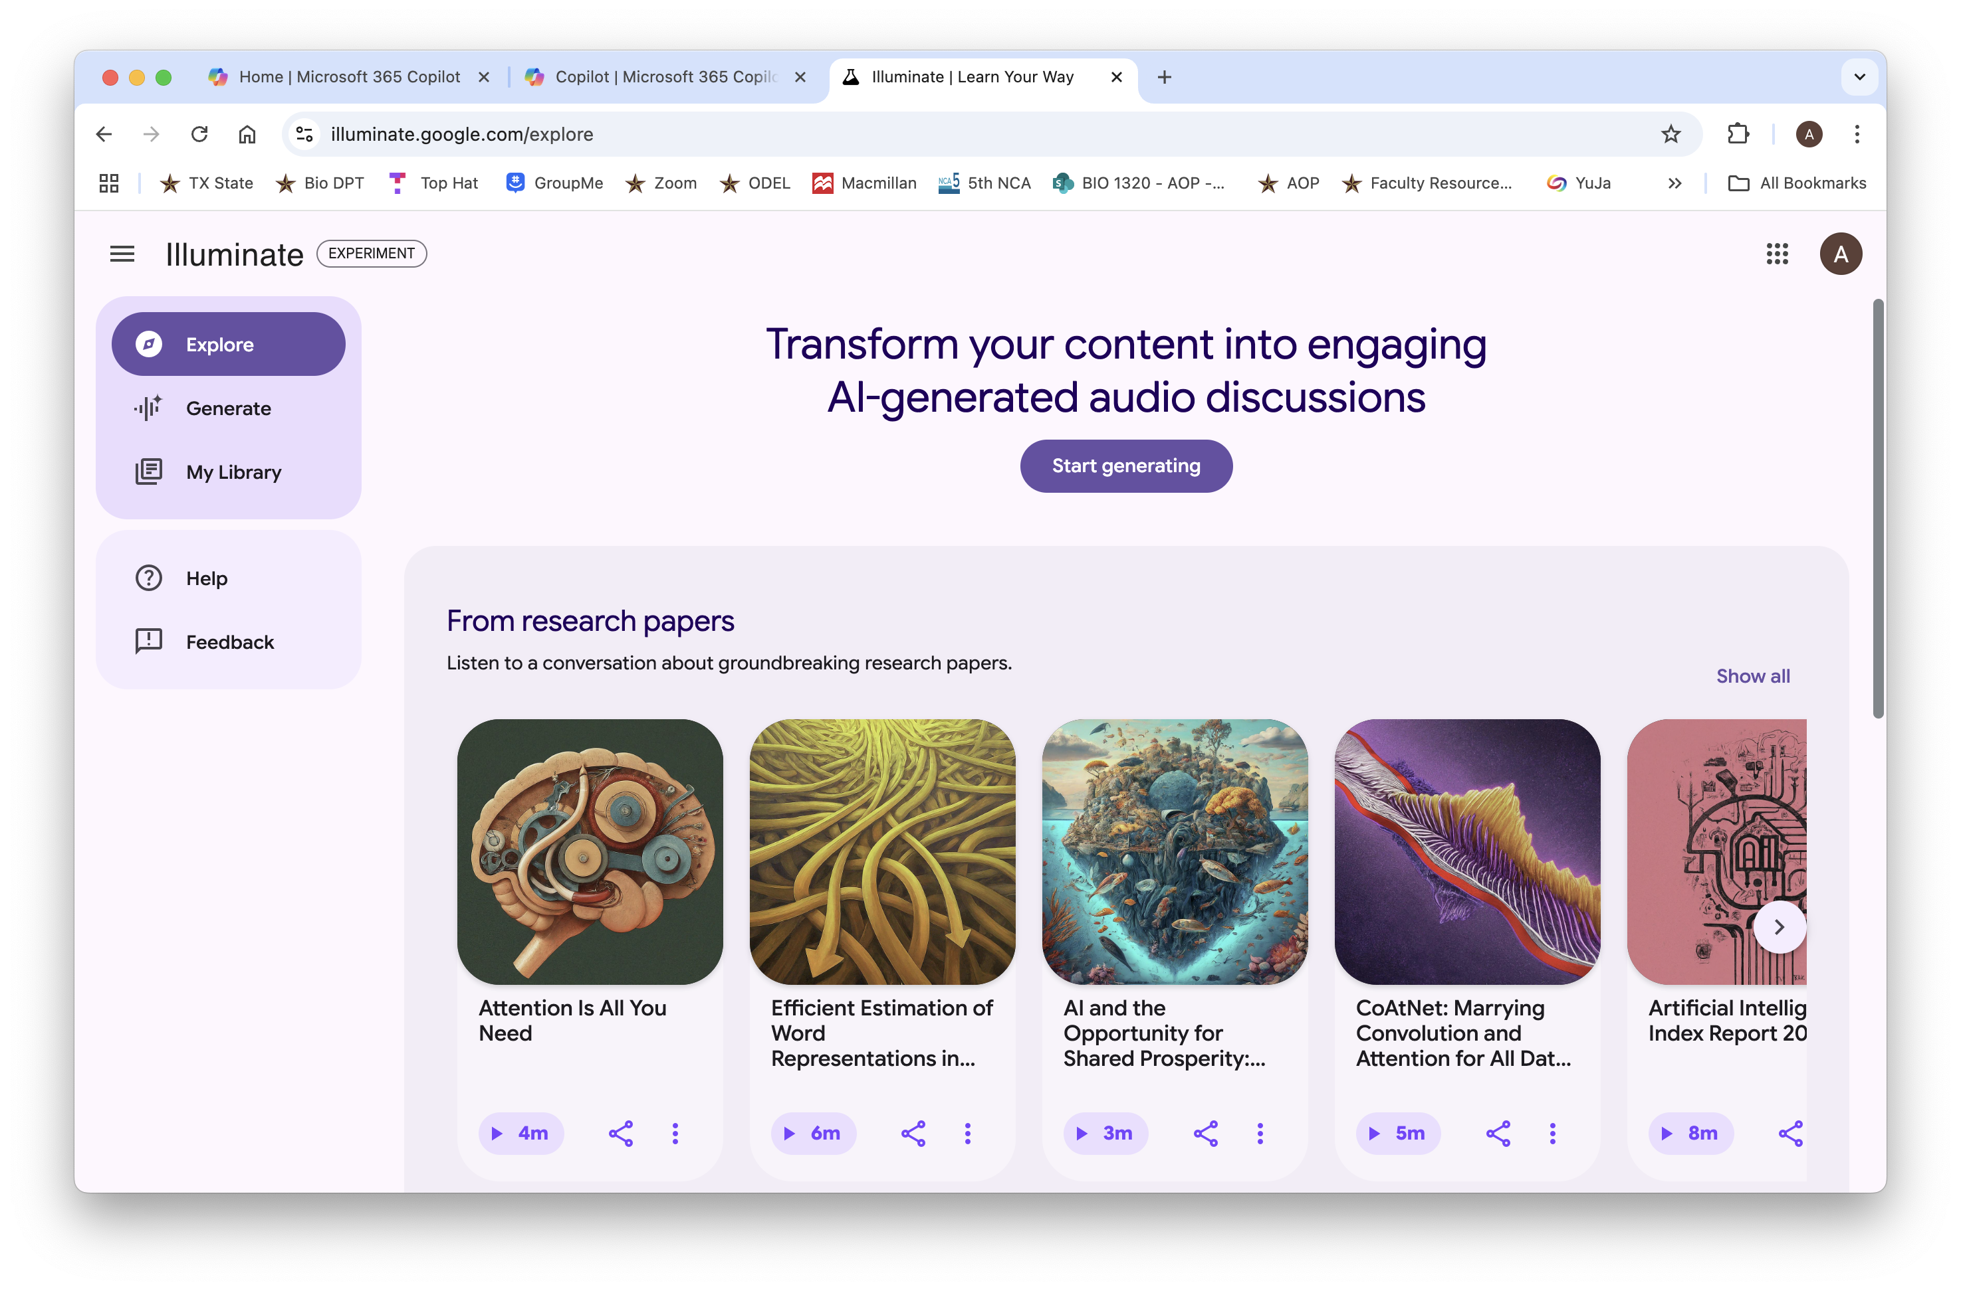
Google Illuminate example
https://illuminate.google.com/explore

Slide 14
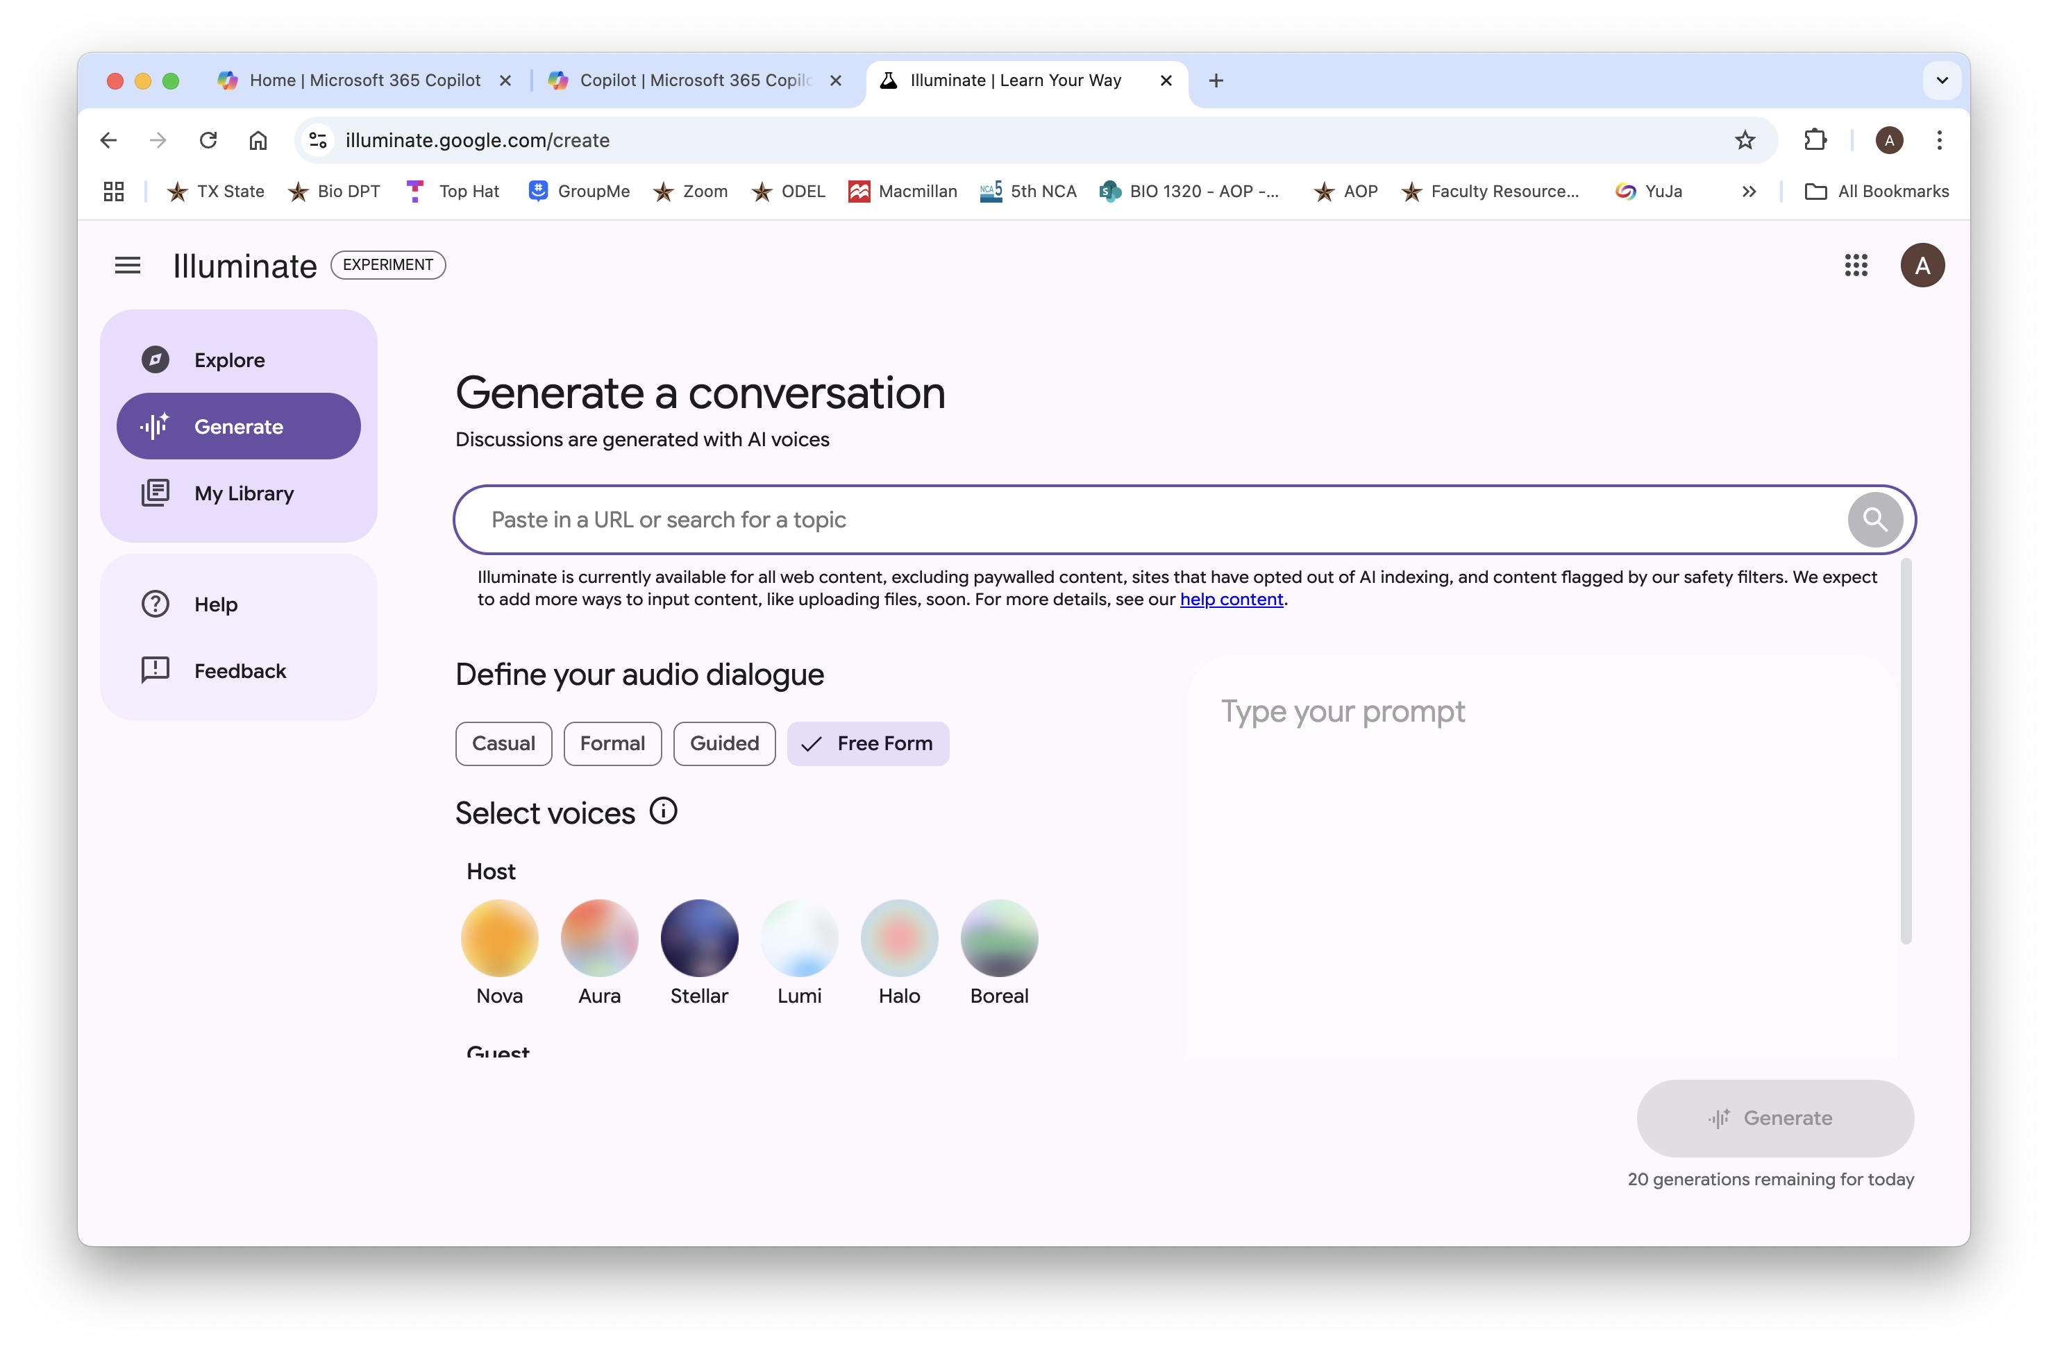
Generate with Google Illuminate
https://illuminate.google.com/create

Slide 15
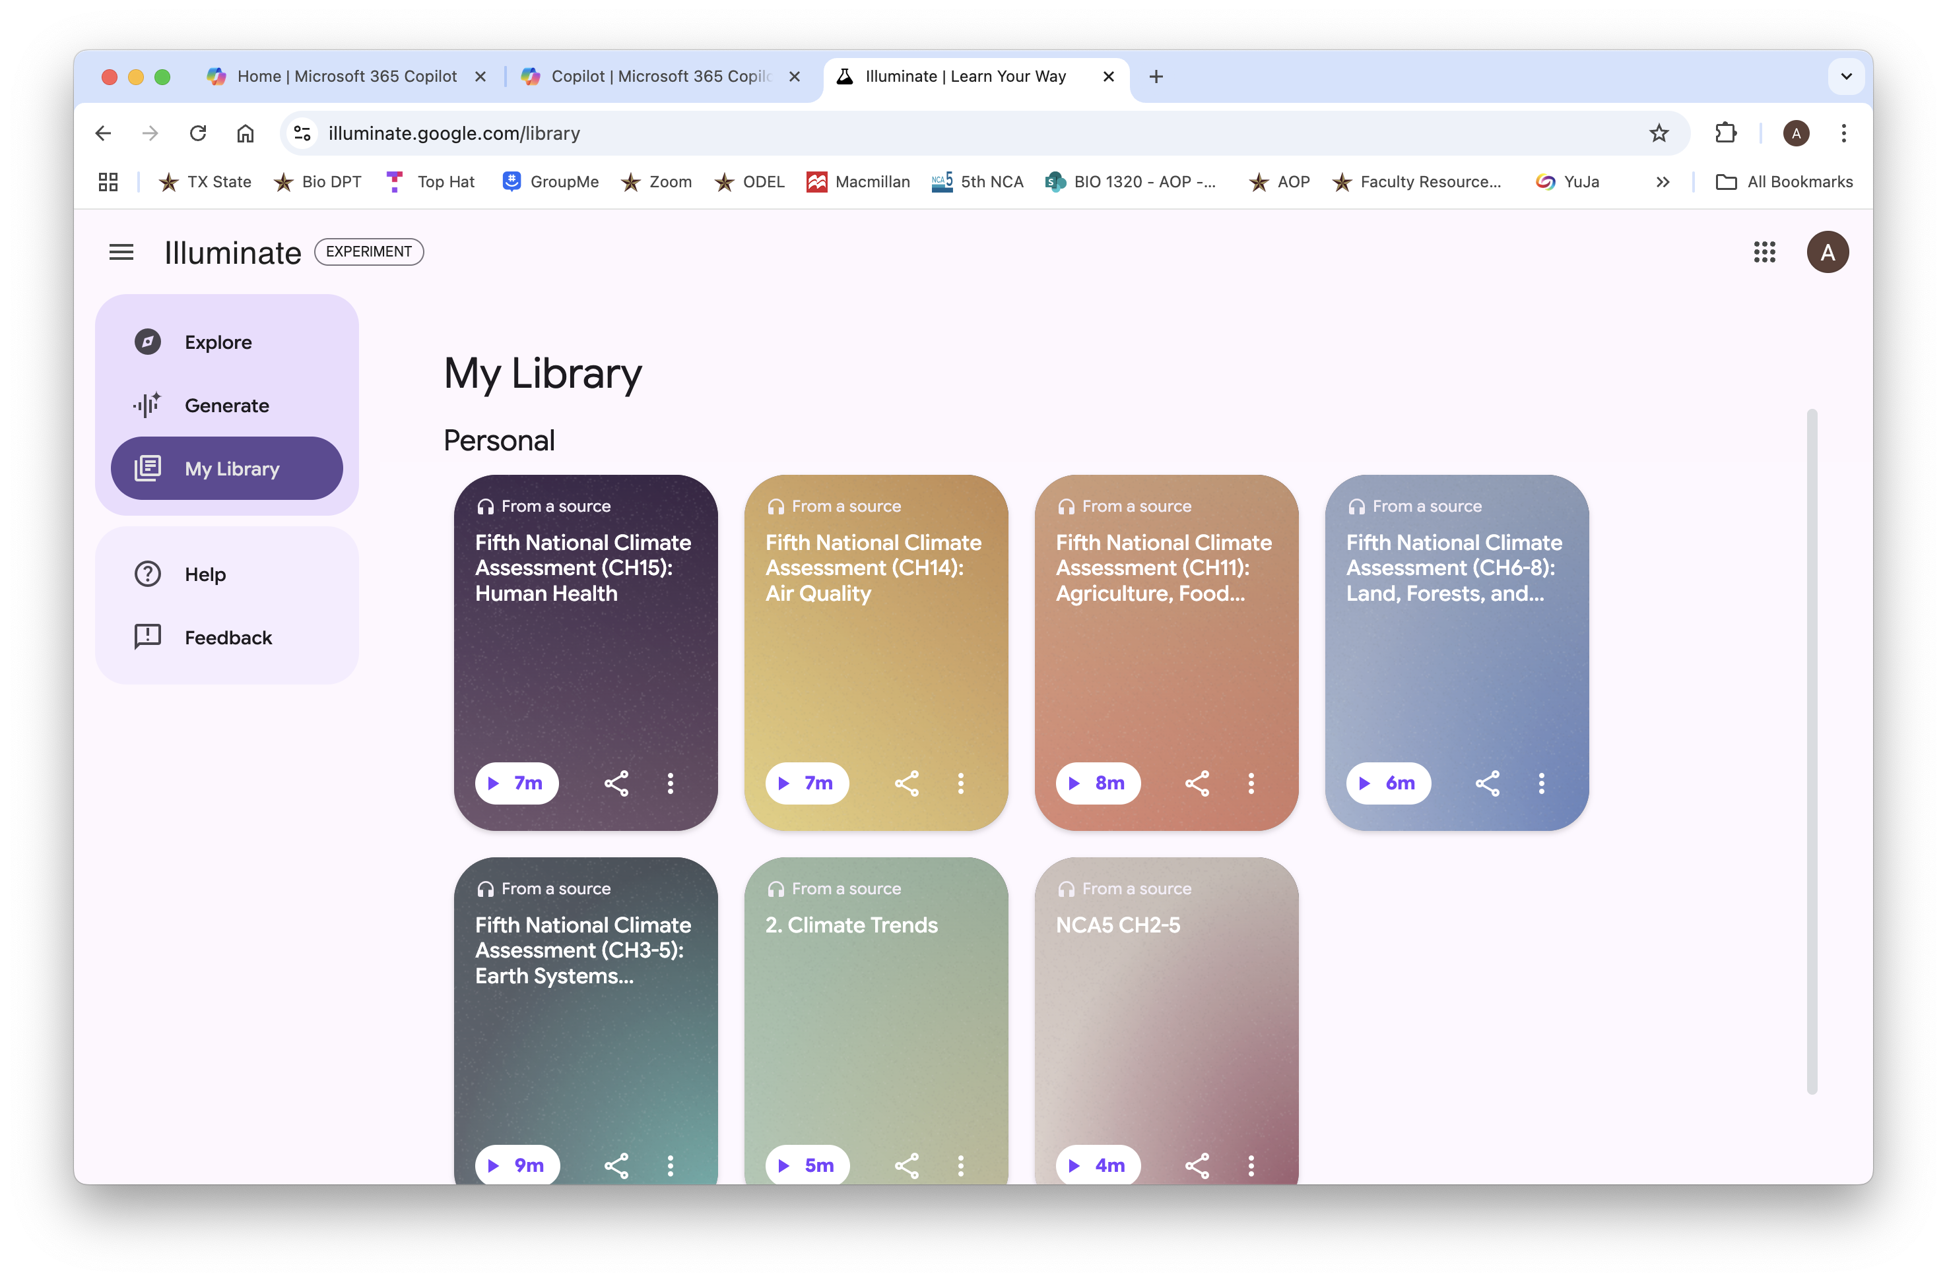
My Library in Google Illuminate
https://illuminate.google.com/library
Fifth National Climate Assessment (CH11): Agriculture, Food Systems, and Rural Communities

Slide 16

Your turn to try Google Illuminate
Is there a paper you would like students to read for the main messages, but you think they might get bogged down by the complexity, length, etc.
Go to https://illuminate.google.com/create
Try to create a Podcast

Slide 17
Making Videos with VISLA is a snap
Visla is an AI tool that helps create professional educational videos from text, scripts, or existing footage
Usages
  Video Creation: Produce lesson videos, digital storytelling projects, and personalized learning content
  Editing Tools: Use features like AutoCut and AI Summary to create concise and engaging videos
  Flipped Classroom: Implement the flipped classroom model with AI-generated videos

Slide 18
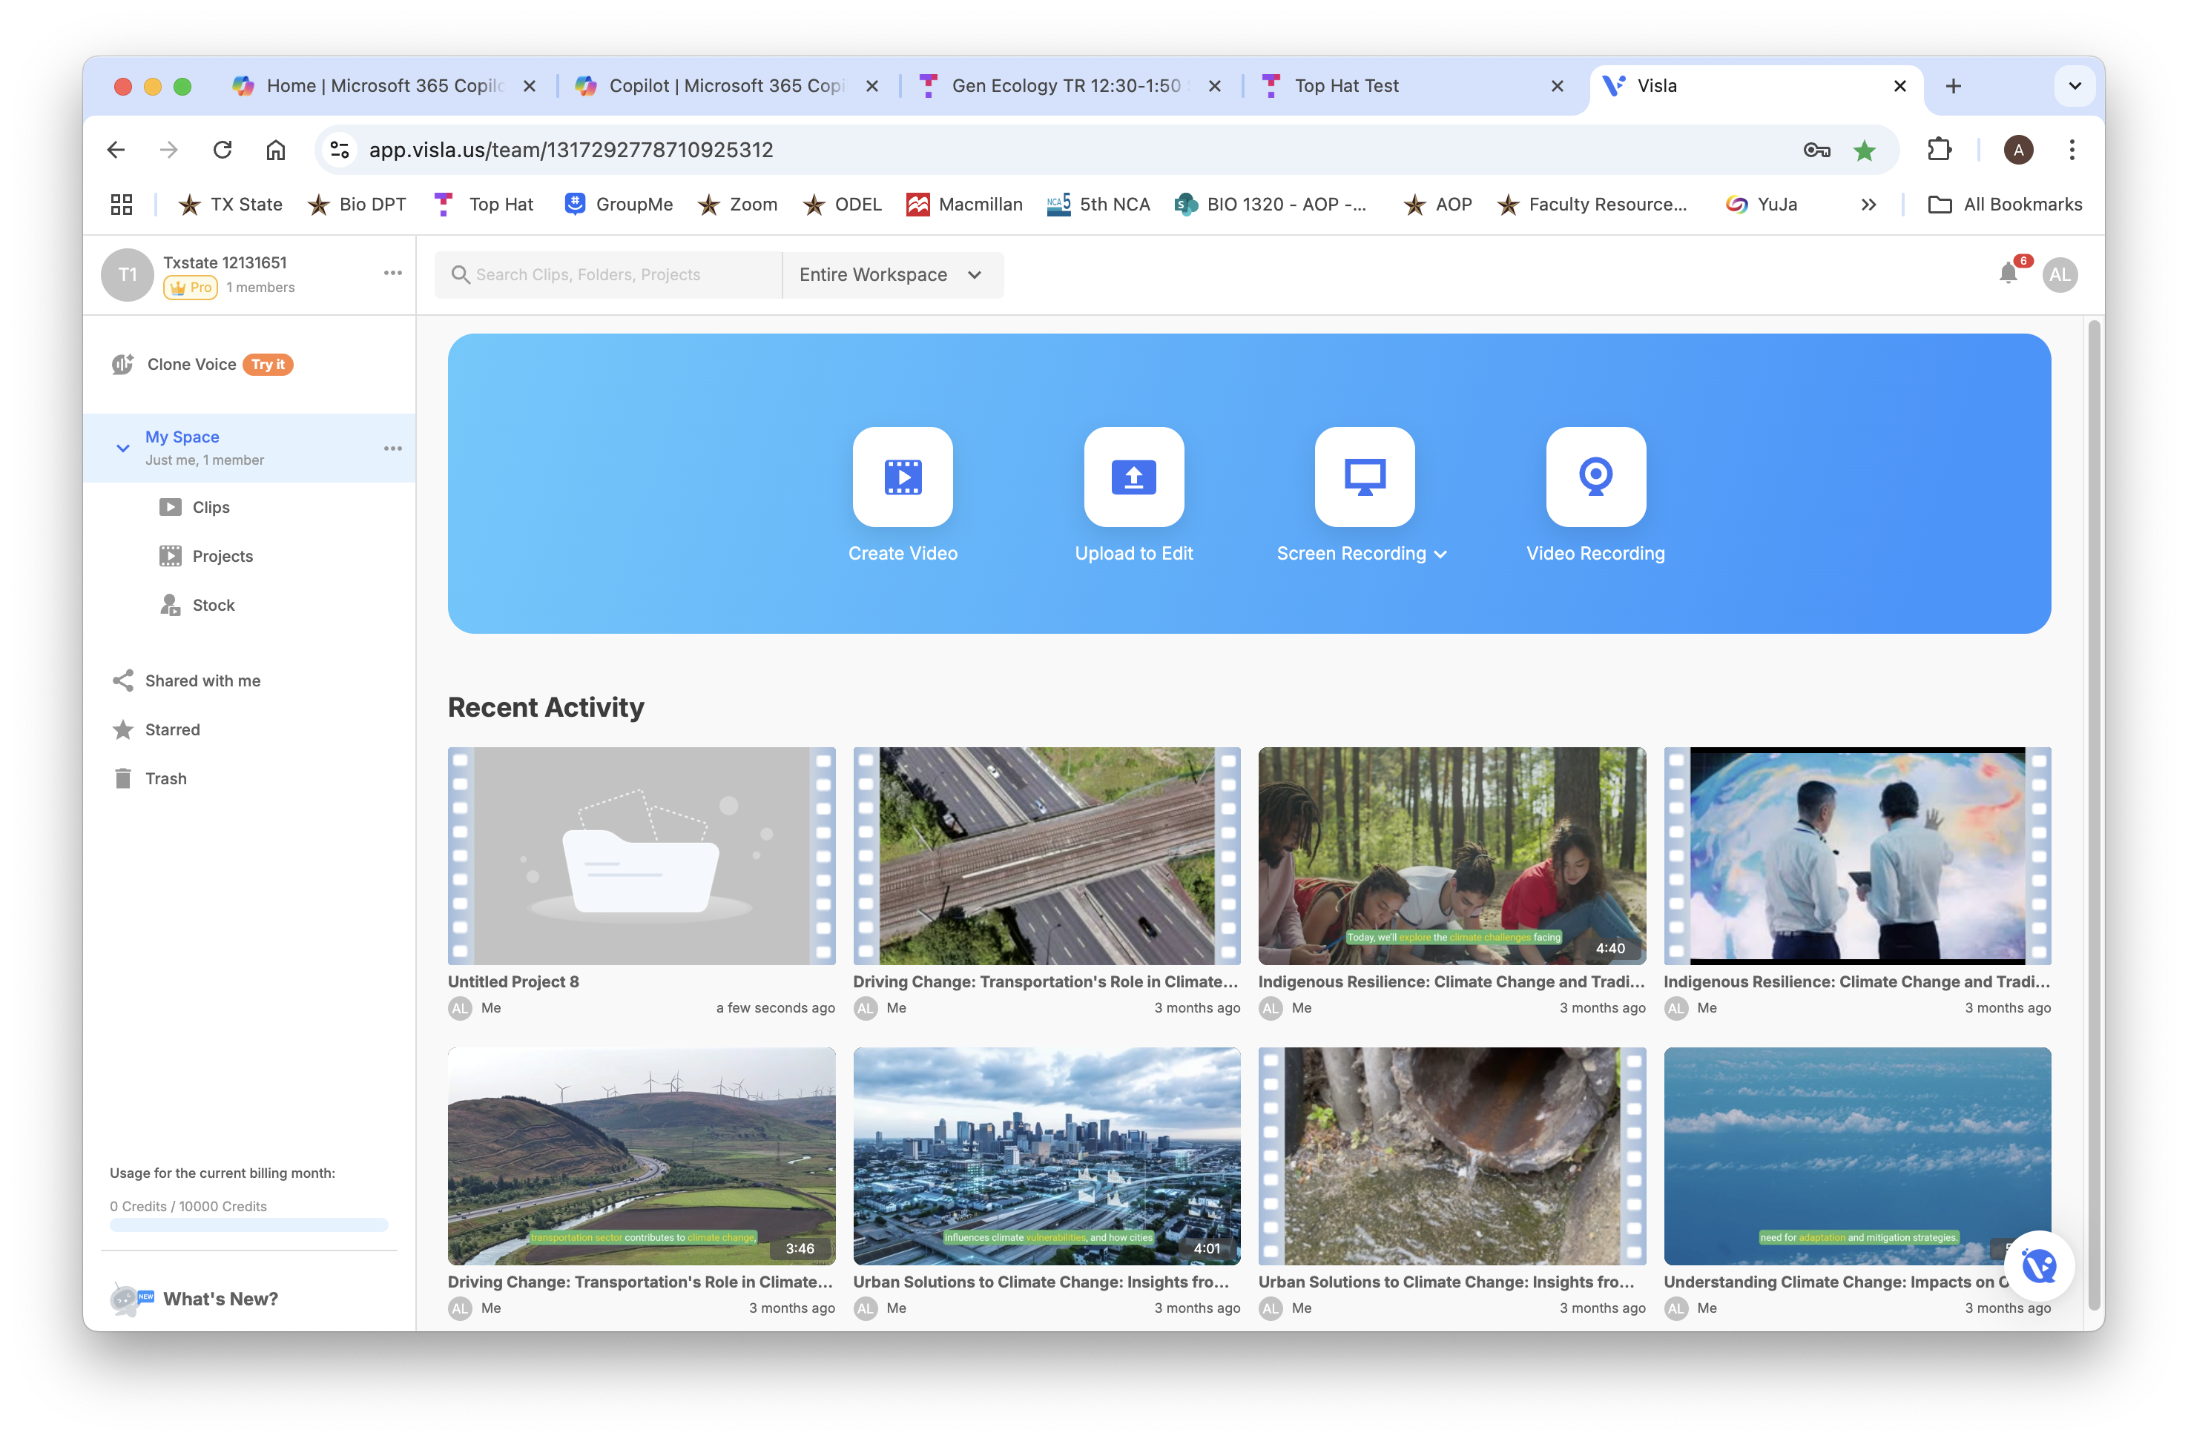
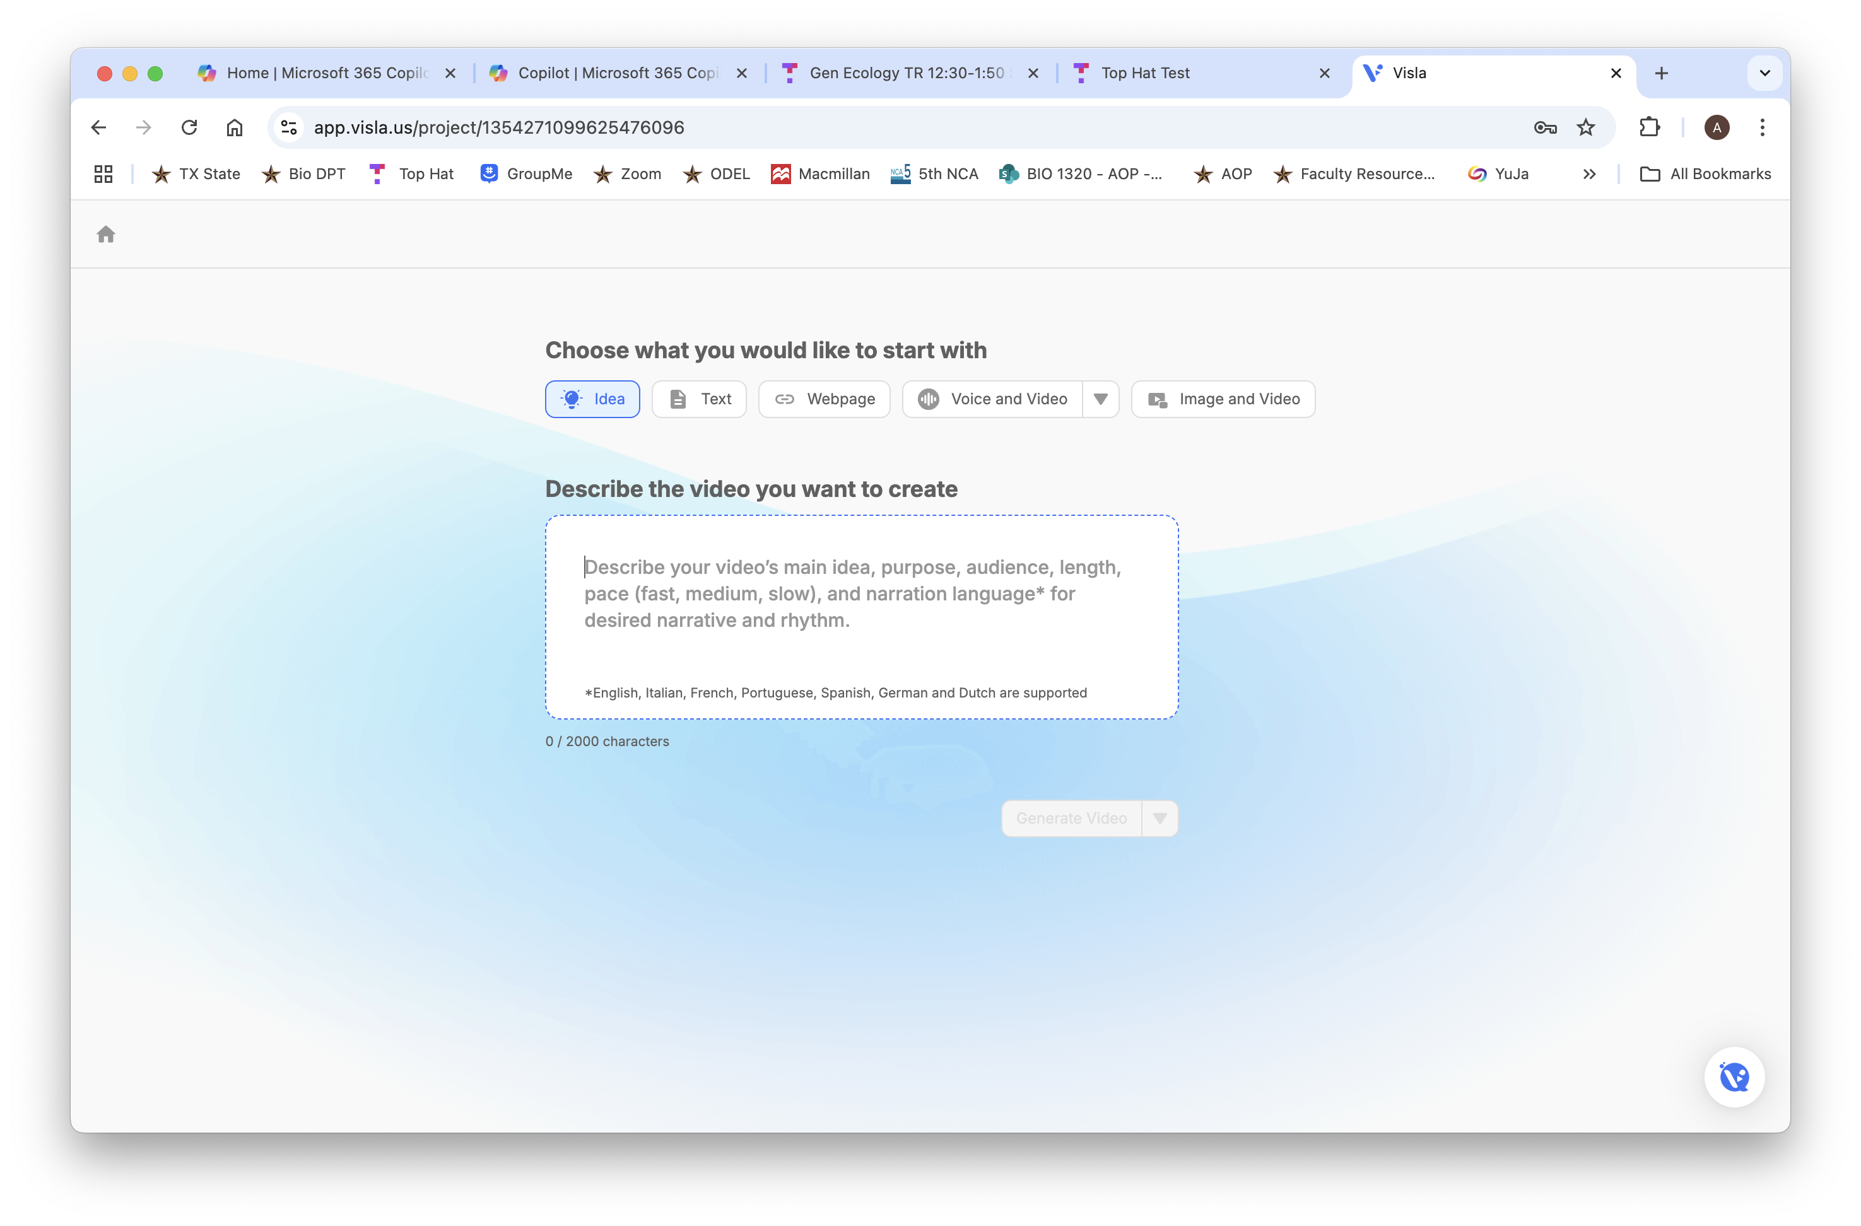
Visla interface
https://www.visla.us/

Slide 19
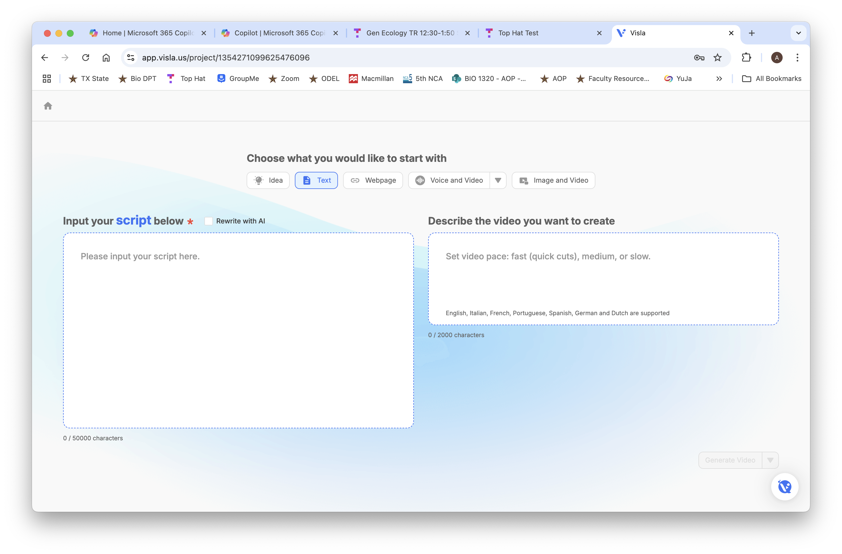
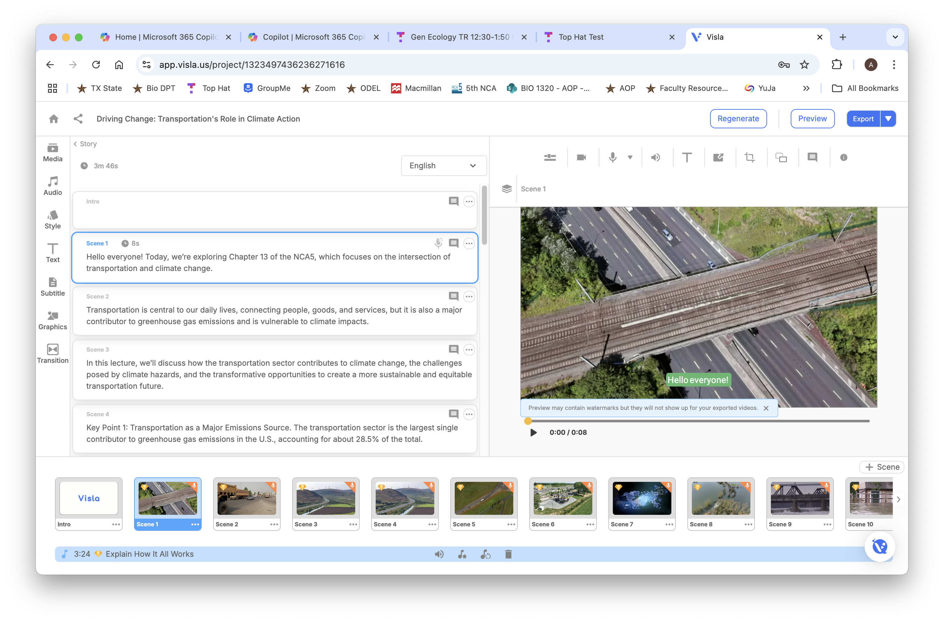
Visla: from text to a video
Driving Change: Transportation's Role in Climate Action

Slide 20

What would you use VISLA for?

Slide 21
Any Questions?
Anica Lee, PhD
Anica_d_lee@txstate.edu

